Slide 1


Roots of Rotary
RLI - Part 1
Notes:
Begin the session:
District Chair welcomes group and introduces District Leadership
Introduce self and session
Describe format for the session
Talk about what materials are available and/or where they can be found
Participant materials accessed online as directed in registration confirmation

Slide 2
Goals:
Discuss
Discuss Rotary’s Guiding Principles
Develop
Develop Understanding of What Rotary’s Guiding Principles Mean Today
Recognize
Recognize the Value of Rotary’s History, Administration and Organization
Reflect
Reflect on How this Understanding Affects Your Role and the Community’s Role in the Community and World
Notes:
Review Session Goals, where this course fits into the Membership curriculum of RLI
Point out INS-ROR 2 – People of Action Campaign
The Participant Manual provides relevant resources for participants with thought provoking questions and activities. Some content and activities provided during this session will supplement but not necessarily directly follow what is found in the participant manual.

Slide 3

Rotary Comes with a Set of Instructions
Object of Rotary
Avenues of Service
Code of Conduct
Four Way Test
Where can new Rotarians find them? (CHAT)
Notes:
Point out “Rotary’s Set of Instructions listed on the slide
Ask participants the question:
Where do you find these Rotary Documents? Raise your VIRTUAL Hand and unmute to respond
Respond to ideas offered by the group
If not already mentioned share places where they are located
RI, District and Club websites
Rotarian Magazine
RLI Participant Manual Part 2 Rotary & Ethics

Slide 4
Guiding Principles of Rotary
THE OBJECT OF ROTARY
The Object of Rotary is to encourage and foster the ideal of service as a basis of worthy enterprise and, in particular, to encourage and foster:
The development of acquaintance as an opportunity for service;
High ethical standards in business and professions, the recognition of the worthiness of all useful occupations, and the dignifying of each Rotarian’s occupation as an opportunity to serve society;
The application of the ideal of service in each Rotarian’s personal, business and community life;
The advancement of international understanding, goodwill and peace through a world fellowship of business and professional persons united in the ideal of service.
Notes:
Set up the rest of the session with the following: For the next 30-45 minutes we will be looking into the history of Rotary or our ROOTS, and find out some interesting things about from where we have come as an organization.
Using the following slides briefly review all the guiding principles of Rotary.
Discuss the Object of Rotary with the participants
Point out how service is built into all four statements
Advance through next couple of slides fairly quickly as you point out guiding principles

Slide 5
Avenues of Service
Club Service
Vocational Service
Community Service
International Service
New Generations
Notes:
Point out that the early Rotarians developed the “Avenues of Service” to help guide our service activities
Set up two additional principles that form the foundation of Rotary and model behavior of Rotarians
Advance to next slide

Slide 6
Two Other Guiding Principles
Rotary Code of Conduct
Act with integrity and high ethical standards in my personal and professional life
Deal Fairly with others and treat them and their occupations with respect
Use my professional skills through Rotary to mentor young people, help those with special needs and improve people’s quality of life in my community and world
Avoid behavior that reflects adversely on Rotary or other Rotarians
The Four Way Test
OF THE THINGS WE THINK SAY OR DO:
Is it the TRUTH?
Is it FAIR to all concerned?
Will it build GOODWILL and BETTER Friendships?
Will it be BENEFICIAL to all concerned?
Notes:
1. Four-way test and Code of Conduct form the foundation of Rotary and model the behavior of Rotarian

Slide 7
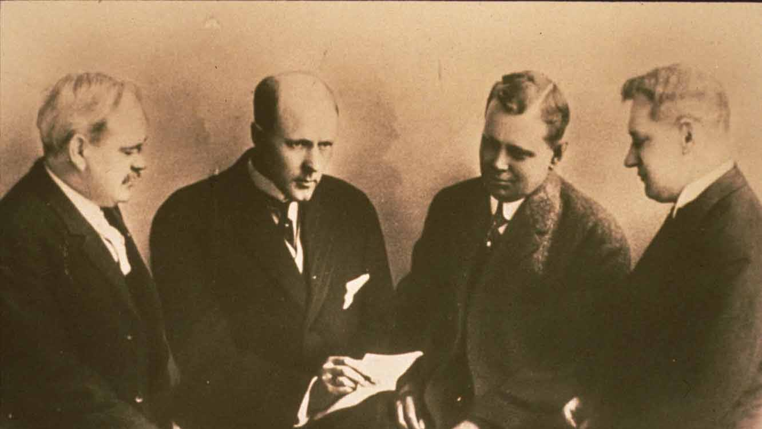
Exploring Our Roots
History & Mission Questionnaire
Rotary Awareness
Notes:
Refer participants to page 3 of Part 1 Participant Manual / Roots of Rotary INS: 1 ROR - “Good to Know” Sheet for their review and reference
Introduce History & Mission Questionnaire:
Let’s explore some history together using a True/False Rotary Questionnaire. Review the questionnaire and respond to each statement by checking TRUE/FALSE after each.
Access document(s) from Documents for Class in My Event
Give participants about 10 minutes to respond to the questions on the questionnaire
Use the questionnaire as a starting point to discuss the history of Rotary, the evolution of many of the features of Rotary and how we got to where we are now.
As time allows conduct the Rotary Awareness quiz using the same method of distribution

Slide 8

Rotary from 1907 to the Present
Do the issues addressed in the previous activity connect to things you do in your club?
What are your thoughts concerning how Rotary’s History led to what the organization is today?
Notes:
Connect the history of Rotary to the present state of the organization
Fast forward 100+ years after Rotary’s founding. How do some of the issues addressed in these ‘tests’ relate to what you might be doing in your club today? How did Rotary’s history lead to what the organization is today?
Spend about 5 minutes in this discussion

Slide 9

People of Action Campaign
Notes:
Introduce “People of Action” Campaign
Rotary developed the “People of Action” Campaign. Insert ROR-2 contains text from Rotary’s People of Action Campaign.
Refer to People of Action as a contemporary and “action-oriented” which takes on many aspects of The Object of Rotary.
Encourage participants to further explore this program
Provide links on where to find this resource

Slide 10
For Your Consideration…..
How does your new knowledge of Rotary History change your perception of what it means to be a Rotarian?
Notes:
To end this session, provide the above question for reflection – give them a minute to read the slide
Give an opportunity for participants to share their thoughts
This is a reflection question for the participants and a last opportunity for them to comment on the session
There are no wrong answers and facilitators should make connections between our individual “INSTRUCTIONS”, the Object of Rotary and other tenets of our organization, like the 5 Avenues of Service, “Service Above Self” and the great things Rotarians do in their clubs, communities and around the world
They are part of a distinguished history of collective and individual service called Rotary. These tenets are the Roots of Rotary

